Slide 1
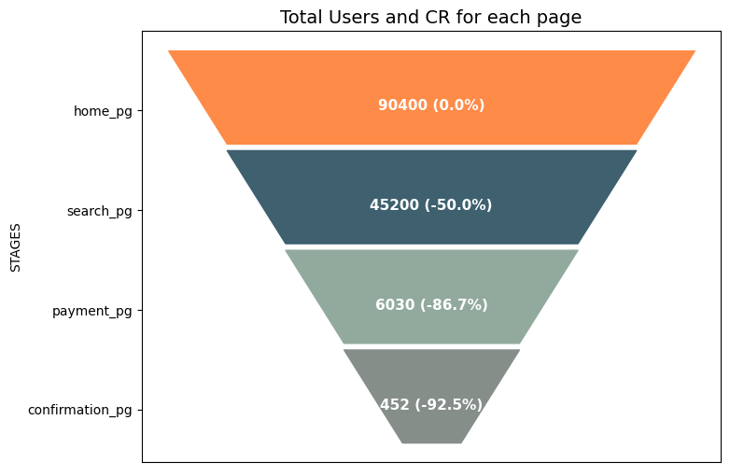




Number of Users / % CR
Only 0.5% of the user population completes the funnel.

Slide 2
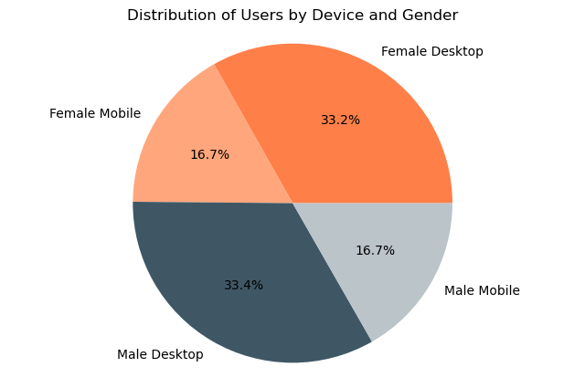
2/3
Users use
DESKTOP
49.9%
User population FEMALE
1/3
Users use
MOBILE
50.1%
User population MALE

Slide 3

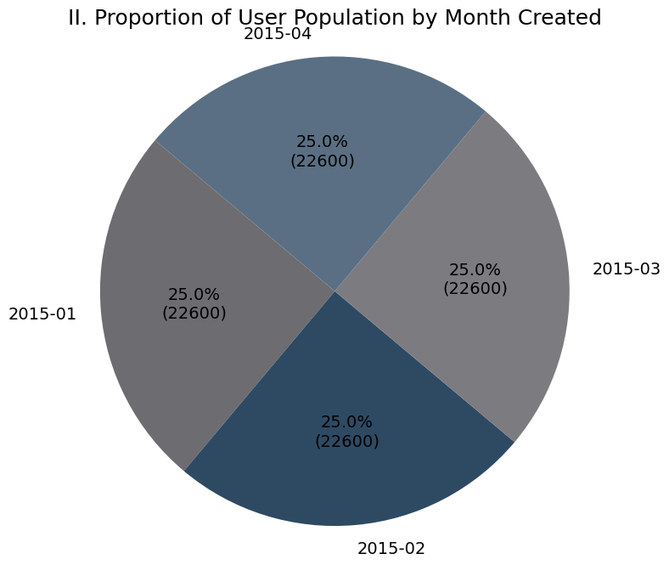
2/3
Users use
DESKTOP
49.9%
User population FEMALE
1/3
Users use
MOBILE
50.1%
User population MALE

Slide 4
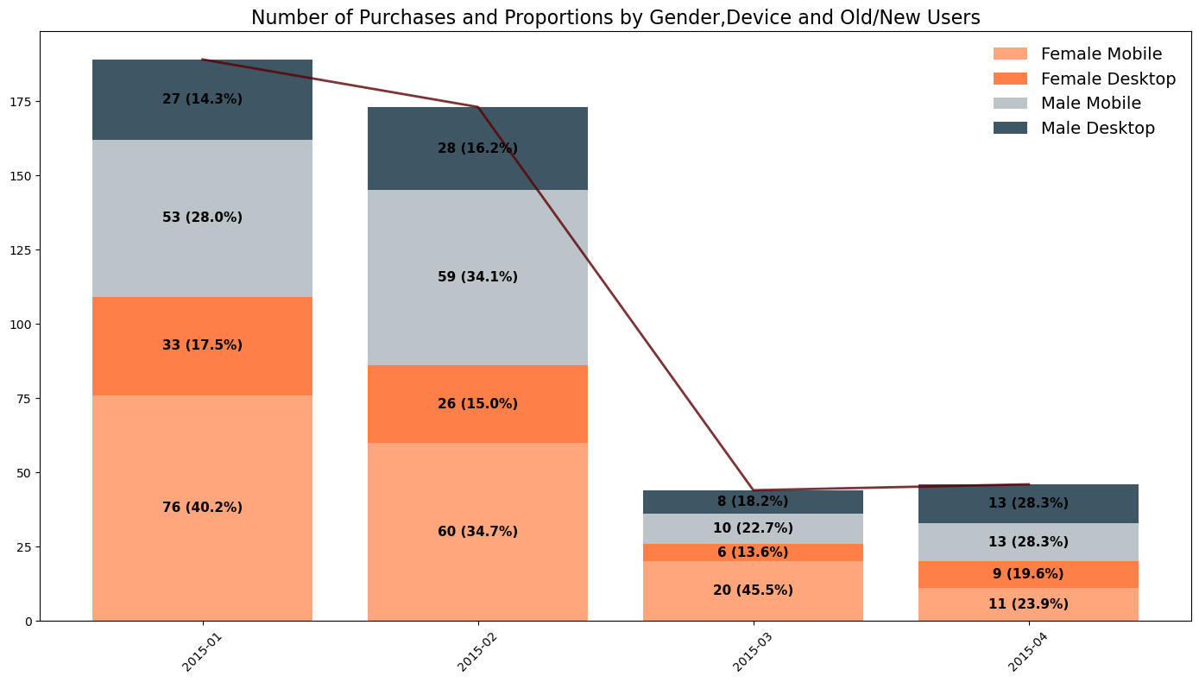
OLD USERS
NEW USERS

